Slide 1
Python

Slide 2
Q1. What is Python?
Ans. Python is a highly readable object-oriented programming language with automatic memory management. It is the language that can be written with English keywords, while other languages use punctuations.
Python is easy to learn, portable and it is open-source. It is designed to solve simple as well as complicated operations. It also supports multiple languages such as C, C++, and Java.
Q2. What is PEP 8?
Ans. PEP 8 (Python Enhancement Proposal) is a Python guide used for the formatting of Python code. It helps to increase the readability and provide the functionality to the source code.
Q3. Why is python different from other scripting languages?
Ans. Python is different from other programming languages in many ways:
• Python is easy to read and write
• It is free. Users can easily share, copy, and edit it.
• It can be used with multiple platforms, so the programmers do not have the platform issue.
• It is an object-oriented programming language and a piece of programming code can be reusable.

Slide 3
Q4. Explain the key features of Python?
Ans. Following are multiple features that make python different from other languages:
• Easy to learn: Python is a programmer-friendly language that it is easy to learn in just a few days. It uses fewer keywords as
compared to other object-oriented languages and anyone can learn it
• Object-oriented: Python is both procedure-oriented and object-oriented programming language. In procedure-oriented languages,
procedures can be used again. Python allows developers to use object oriented approach to develop applications.
• Open-source and free: Python is an Open-source language that means anyone can easily access the programming and
development. There is an open forum online where the number of coders contributes to improving this
language.
• High-level language: Python is defined as a high-level language because of this feature. You do not need to keep an eye on
programming structure, memory management, and architecture of the code.
• Extendable & Scalable: Python is extendable as it can be extended by using different modules to its interpreters. It helps
developers to modify the program. It also provides scalability to the large codes by providing support and
good structure to it.

Slide 4
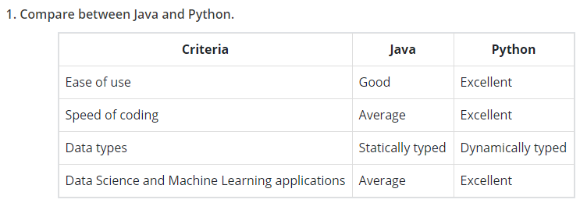
Q8. What are the basic data types in Python?
Ans. There are five basic data types in Python:
• Numbers
• String
• List
• Tuple
• Dictionary

Slide 5
Q14. Is Python an Interpreted or a Compiled language?
Ans. Python is an interpreted language. It converts the source code that is written by the programmer into an intermediate language, which is
again translated into machine language before being executed.
Q18. What is Web Scraping? How do you achieve it in Python?
Ans. Web Scraping is a way of extracting the large amounts of information available on the web sites and saving it onto the local machine or
the database tables. Python has few modules for scraping the web like urllib2, scrapy, pyquery, BeautifulSoap, etc.
Q19. How do you copy an object in Python?
Ans. We can copy an object in Python by using the functions copy.copy() and copy.deepcopy()
Q20. Name a few libraries in Python used for data analysis and scientific computations.
Ans. Some of the libraries used for data analysis and scientific computations are NumPy, SciPy, Pandas, SciKit, Matplotlib, Seaborn.
Q21. Why should one use NumPy arrays instead of nested Python lists?
Ans. NumPy’s arrays are more compact than Python lists — a list of lists as you describe, in Python, would take at least 20 MB or so, while a
NumPy 3D array with single-precision floats in the cells would fit in 4 MB.

Slide 6
Q44. Name some standard Python errors.
Ans. Some standard errors in Python are –
• TypeError
• ValueError
• NameError
• IOError
• IndexError
• KeyError
We can use dir(__builtin__) to list all the errors in Python.
Q46. What is multithreading?
Ans. Multithreading stands for running a number of programs simultaneously by invoking multiple threads.

Slide 7
Q39. How to delete a file?
Ans. We can delete a file in Python by using a command os.remove (filename) or os.unlink(filename).
Q49. Which python library is used for Machine learning?
Ans. Scikit-learn python Library is used for Machine learning.
Q50. What is the role of len() in python?
Ans. len() is used to determine the length of an array, list and string in the program.
Example:
str1=’1234’
len(str1)

Slide 8
Q56. Which databases are supported by Python?
Ans. MySQL (Structured) and MongoDB (Unstructured) are supported by Python. First, the modules should be imported to the library to interact with the database.
Q57. What is the output of the following code?
demoCodes = [1, 2, 3, 4]
demoCodes.append([5,6,7,8])
print len(demoCodes)
Ans. Output: 5
Reason: ‘append’ method is used in the code, which has to append the existing object into the list. But the append method does not merge the list, which is added as an element. So, the output will be’5’.
Q58. What is the use of the ‘#’ symbol in Python?
Ans. ‘#’ symbol is used to symbolize the comments
print (“I am a quick learner”)
#print (“I am a quick learner”)

Slide 9
Q60. What is the maximum length of an identifier in python?
Ans. The maximum possible length of an identifier in python is 79 characters
Q61. Can you tell me the generator functions in Python?
Ans. Generator functions help to declare a function that behaves like an iterator in a fast, easy, and neat way.
Q62. Write a code to display the current time.
Ans. Here is the code to represent the current time:
import datetime
now = datetime.datetime.now()
print (“Current date and time : “)
print (now.stgftime(“%Y-%m-%d %H:%M:%S”))
Q63. Is Python a case-sensitive programming language?
Ans. Yes, it is a case-sensitive language like other languages such as Java, C, and C++.

Slide 10
String

Slide 11
Q32. Are Python strings immutable or mutable?
Ans. Python strings are immutable. Ironically, it is not a string, but a variable with a string value.
Q48. How to capitalize the first letter of string?
Ans. To capitalize the first letter of the string, capitalize() method is used. If the string is already capitalized then it will return the original value.
Q54. Write a code to convert a string into lowercase?
Ans. lower( ) is used to convert the string into lower case
str=’XYZ’
print(str.lower())
Output: xyz

Slide 12
List

Slide 13

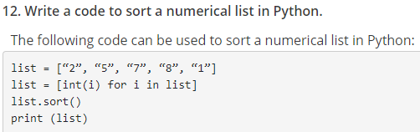
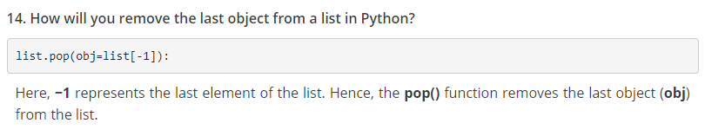
Q59. Suppose a list1 is [2, 44, 191, 86], what would be the output for list1[-1]
Ans. Output: 86
List1[-1] shows the last integer of the list

Slide 14
Q64. Write a code to sort a numerical list in Python.
Ans. To sort a numerical list, use the following code:
list = [“2”, “7”, “3”, “5”, “1”]
list = [int(i) for i in list]
list.sort()
print (list)

Slide 15
Tuple

Slide 16
Q9. Mention the use of tuple in Python?
Ans. Tuple is a data type similar to a list. It is used in programs to group the related data equivalent to the directory.
Example:
list_val = [5, 4, 3, 2]
tup_val = (5, 4, 3, 2)
print(list_val)
print(tup_val)
Output:
[5, 4, 3, 2]
(5, 4, 3, 2)

Slide 17
Dictionary

Slide 18
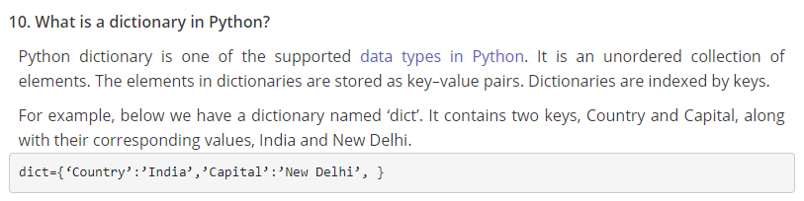

Slide 19
Set

Slide 20
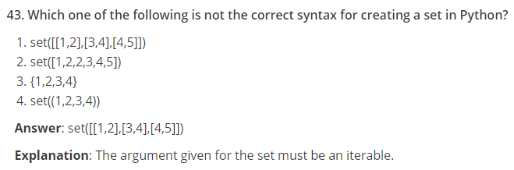
Q43. What is a set?
Ans. A set is an unordered collection of iterable and mutable data, and it has no duplicate elements.

Slide 21
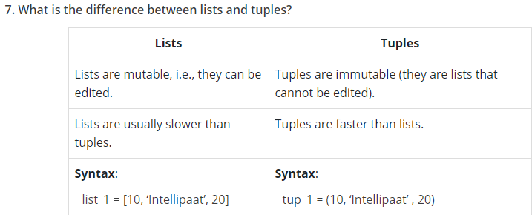

Slide 22
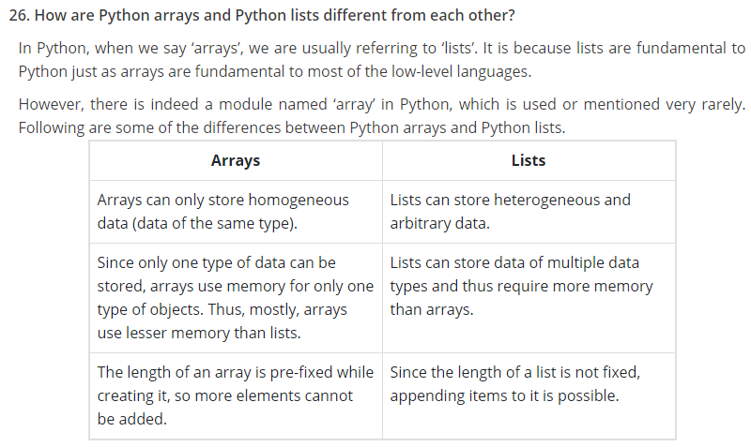

Slide 23
Q11. What is the difference between Python Arrays and Lists?
Ans. Lists and arrays both are used to store data, but the difference is that the List can any hold any data type while arrays can hold a single data type.
Example:
import array as arr
My_Array=arr.array(‘i’,[4,3,2,1])
My_list=[5,’abc’,1.20]
print(My_Array)
print(My_list)
Output:
array(‘i’, [4, 3, 2, 1])
[5, ‘abc’, 1.2]

Slide 24
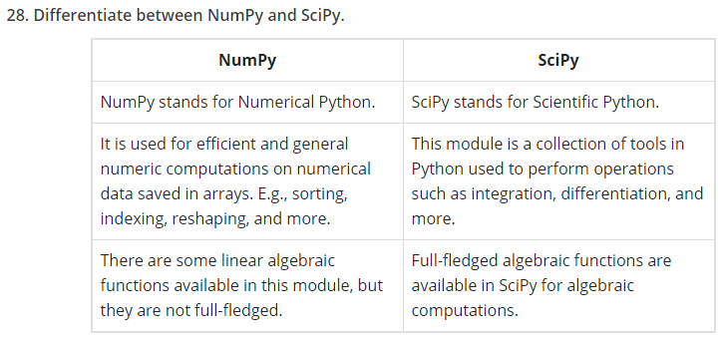

Slide 25
Indexing

Slide 26
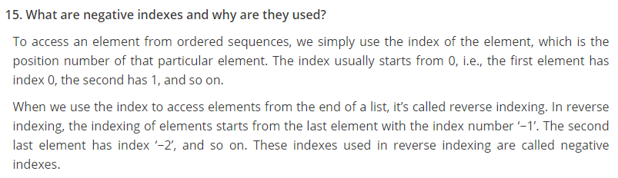

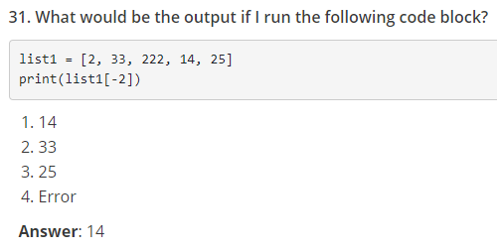

Slide 27
Q55. What is the output of the following code?
nameList = [‘Joe’, ‘Nick’, ‘Bob’, ‘Harry’]
print nameList[1][-1]
Ans. Output: k
Reason: [-1] shows the last element or character of the string. In the above code, ]1] represents the second string and [-1] represents the last character of the second string, i.e., “k.”

Slide 28
Slicing

Slide 29
Q35. What is slicing?
Ans. Slicing is a computationally fast way to methodically access a range of items from sequence types like list, tuple, strings, etc.
Q36. What is the output of the following code?
list1 = [5,4,3,2,1]
list2 = list1
list2[0] = 0;
print “list1= : “, list1
Ans. Output: list1= : [5,4,3,2,1]

Slide 30
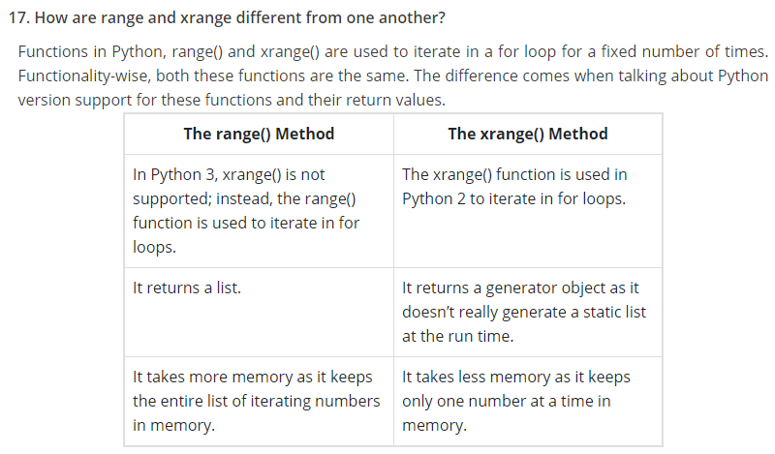

Slide 31

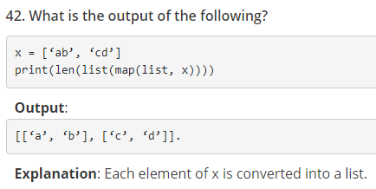

Slide 32
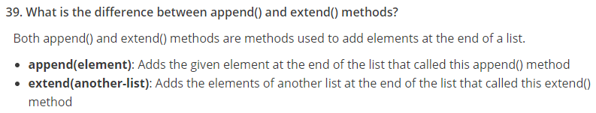

Slide 33
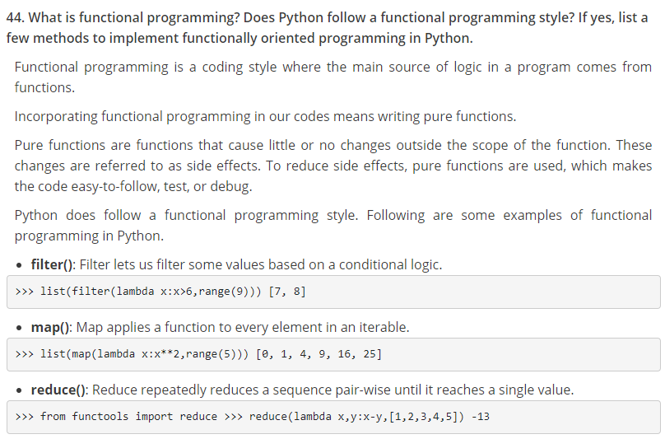

Slide 34
>>> a = [ ]
Not a
Len(a) == 0
OPTION A
OPTION B
OPTIONS A, B
BOTH WRONG

